Slide 1
Employee Data Analysis using Excel
STUDENT NAME : LEELA BHARATHI.P
REGISTER NO : 312209771
DEPARTMENT : b.com (computer application).
COLLEGE : anna adharsh college for women.

Slide 2


Project title
PROJECT TITLE
Employee Performance Analysis using Excel

Slide 3

AGENDA
Project Overview
PROBLEM STATEMENT
End Users
Our Solution and Proposition
Dataset Description
Modelling Approach
Results and Discussion
Conclusion

Slide 4

PROJECT OVERVIEW
Scope: - Collect and import employee performance data into Excel - Develop a dashboard to display key performance metrics (e.g., sales performance, customer satisfaction, attendance) - Create charts and graphs to visualize performance trends and patterns - Implement filters and pivot tables to enable dynamic data analysis - Develop a scoring system to evaluate employee performance - Provide recommendations for future performance improvement initiatives Benefits: - Improved data-driven decision-making - Enhanced transparency in performance evaluations - Increased efficiency in performance tracking and analysis - Better identification of top performers and areas for improvement - Data-driven insights for performance improvement initiatives

Slide 5
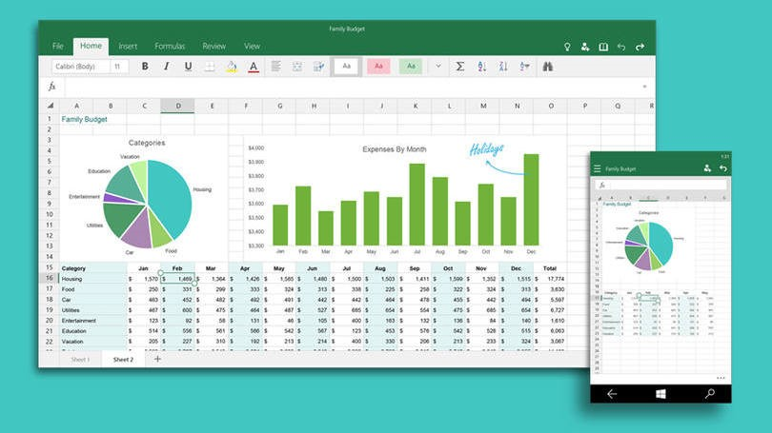
PROBLEM STATEMENT
"The HR department is struggling to effectively analyze and track employee performance data, leading to: - Inefficient use of resources -Poor decision-making - Lack of transparency in performance evaluations - Inability to identify top performers and areas for improvement. Currently, employee performance data is scattered across multiple spreadsheets, making it difficult to: - Consolidate and summarize performance metrics - Identify trends and patterns - Compare performance across teams and departments - Provide actionable insights for performance improvement.
This Photo by Unknown Author is licensed under CC BY

Slide 6

WHO ARE THE END USERS?
HR Generalists/Managers.
Department Managers. Employees.
Senior Leadership.
Talent Management Specialist.
Training and Development Professionals.
Compensation and Benefits Analysts.

Slide 7

OUR SOLUTION AND ITS VALUE PROPOSITION
Solution: - Dynamic filtering and drill -down capabilities - Performance scoring and ranking system - Actionable insights and recommendations for improvement. Value Proposition: - Improved Data-Driven Decision Making -Enhanced Performance Management -Better Talent Identification -Data-Driven Culture

Slide 8

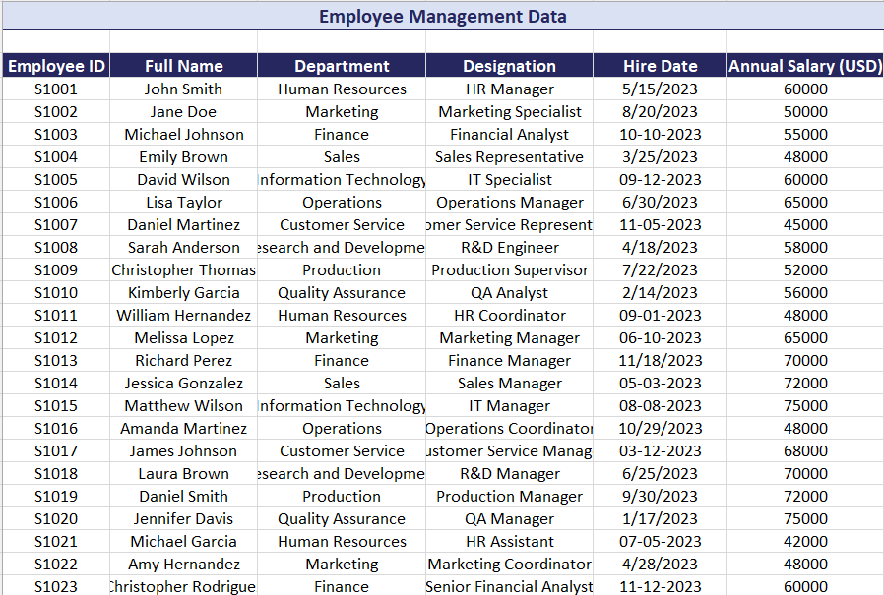
Dataset Description
Employee ID
Full Name
Department
Designation
Hire Date
Annual Salary

Slide 9
MODELLING
1.Department-wise salary distribution
2. Designation-wise salary distribution
3. Salary range distribution
4. Hire date distribution (to identify hiring trends)
5. Employee tenure analysis (time since hire)
6. Department-wise employee count
7. Identification of top earners

Slide 10

RESULTS

Slide 11
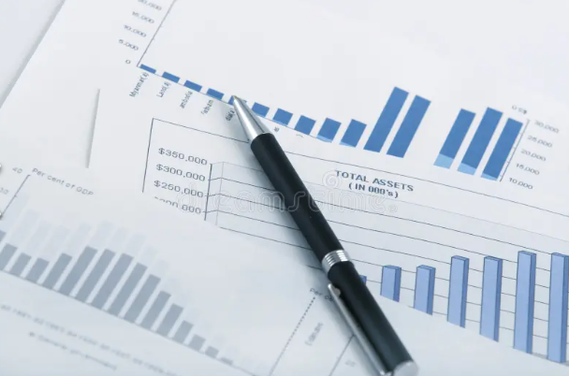
Conclusion
THE CONCLUSION OF MY PROJECT WAS
The topics of my project was EMPLOYEE PERFORMANCE ANALYSIS USING EXCEL.
In This Presentation Based on the employee performance analysis using Excel I has given the project comparisons by excel data of information, about the Employee Management Data and the graph of annual salary of employee .

